Slide 1

Can Machine Learning Predict Stocks?
Rachel
Bellevue University

Slide 2
Introduction
Public companies sell stocks on stock markets so that investors can invest their money in a company, their profits, and have voter rights at shareholder meetings. It is one way a person can build wealth and companies can raise money for products, services, and other initiatives. A person can buy or sell a company’s stock for either a profit or loss (O’Shea, 2020).
Stocks can have high returns, but they also have risks if the price goes down due to unforeseen circumstances
Good or bad news that was made public about a company
Profits were not as high as expected
Widespread viruses affecting the world
Company downsizing or restructuring
Bankruptcies
https://www.nerdwallet.com/article/investing/what-are-stocks-how-they-work

Slide 3
Questions That Are Being Addressed
Is there a way to predict stocks using machine learning even though there are many factors that go into how well stocks perform?
Is it better to predict stocks short-term or use a long-term date range?
Will the future predictions be skewed when there is stock volatility based on recent history?
Why Are these questions Important?
No easy way to predict how stocks will do based on market volatility and other factors
Machine learning, when trained well, may be able help with identifying patterns and trends that other methods do not show
With machine learning, there may be one or so methods that can have a high accuracy rate

Slide 4
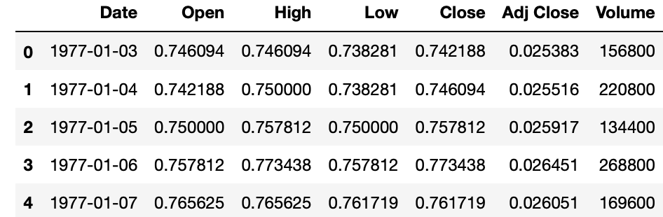
What Did I Do?
Retrieved the Kroger (KR) historical stock prices from the “Stock Market Dataset” that appeared on Kaggle.com
Data contains stock information up to April 1, 2020
Data Fields
Date - specifies trading date
Open - opening price
High - maximum price during the day
Low - minimum price during the day
Close - close price adjusted for splits
Adj Close - adjusted close price adjusted for both dividends and splits
Volume - the number of shares that changed hands during a given day

Slide 5
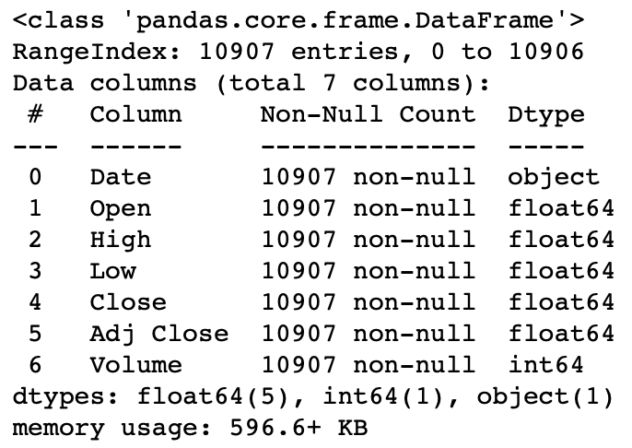
What Did I Do?
Verified the data types of the Kroger dataset

Slide 6
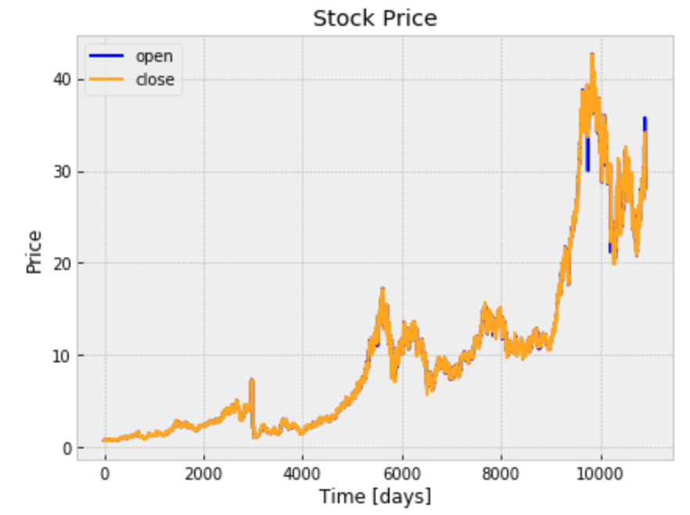
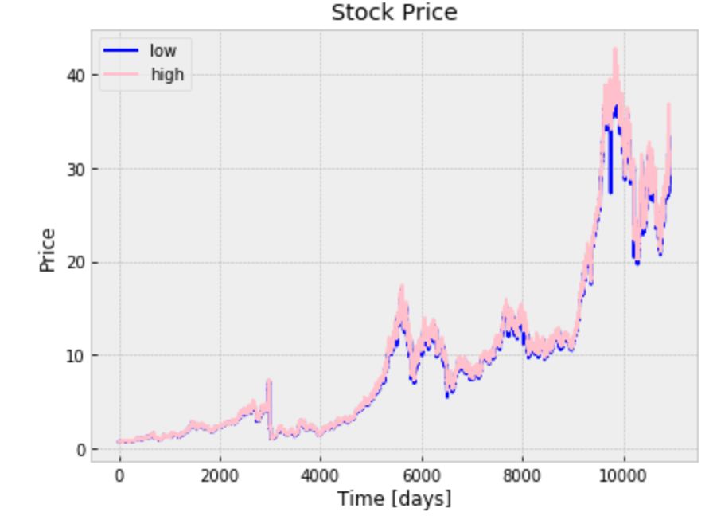
What Did I Do?
The below graphs show the Stock Prices for the Open and Close and Low and Highs for each day

Slide 7
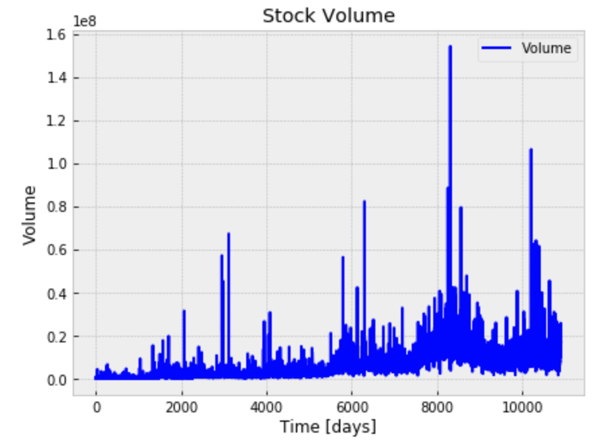
What Did I Do?
For the Stock Volume graph, there were certain times during the date range where the volume of stock that was traded was pretty high
This may be due to a number of factors such as unforeseen circumstances, economic factors, or how well the company was doing at the time

Slide 8
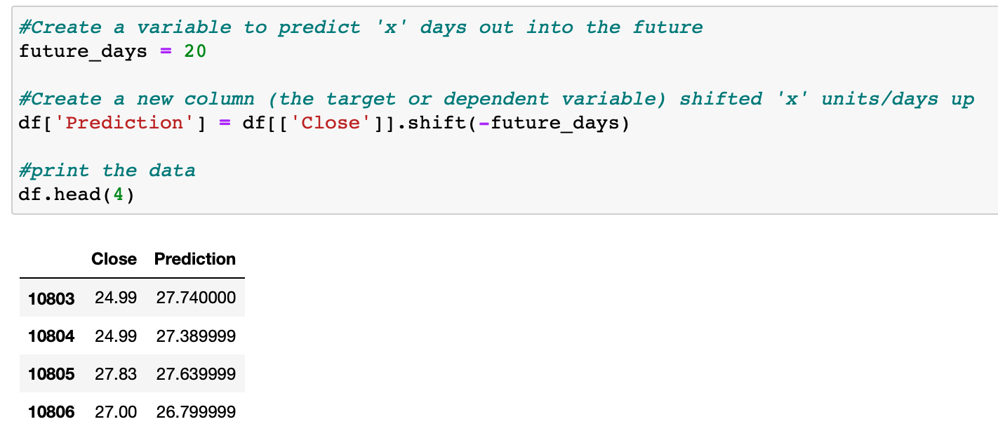
What Did I Do? & Data That Was Used
Once the data set was reviewed, the data was narrowed down to 1/1/20 through 4/1/20
Code to set up the process to use the Linear Regression and Decision Tree models
A new DataFrame was added to add the Close Price and Predictions
Predictions will only include 20 days

Slide 9
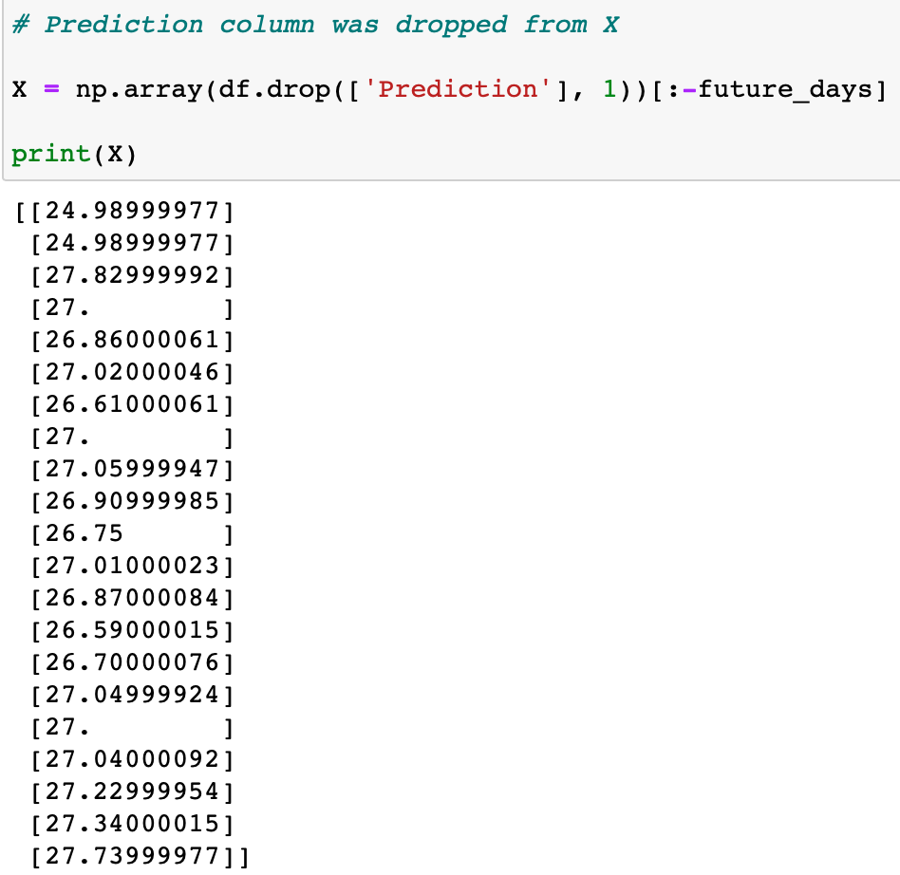
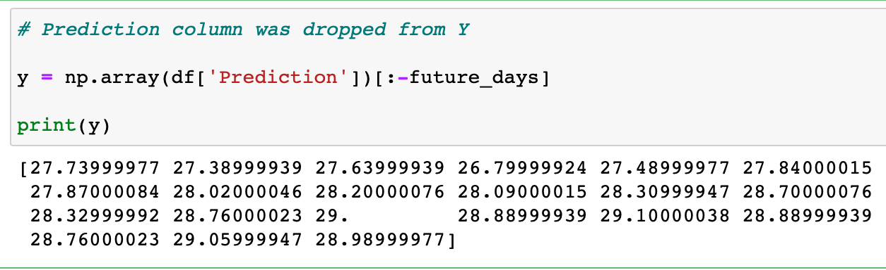
What Did I Do?
#1
#2

Slide 10
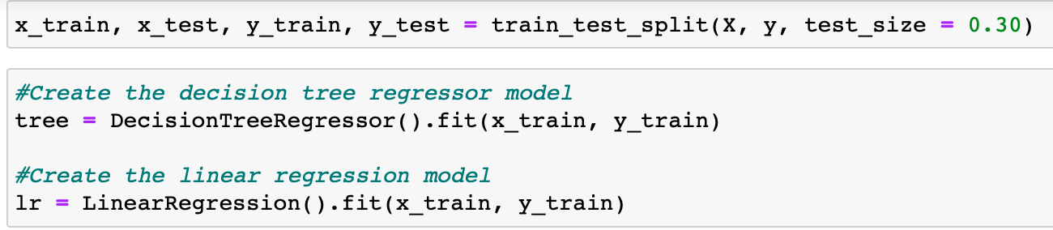
What Did I Do?
30% of the dataset is trained
Decision tree regressor model created
Linear regression model is created

Slide 11
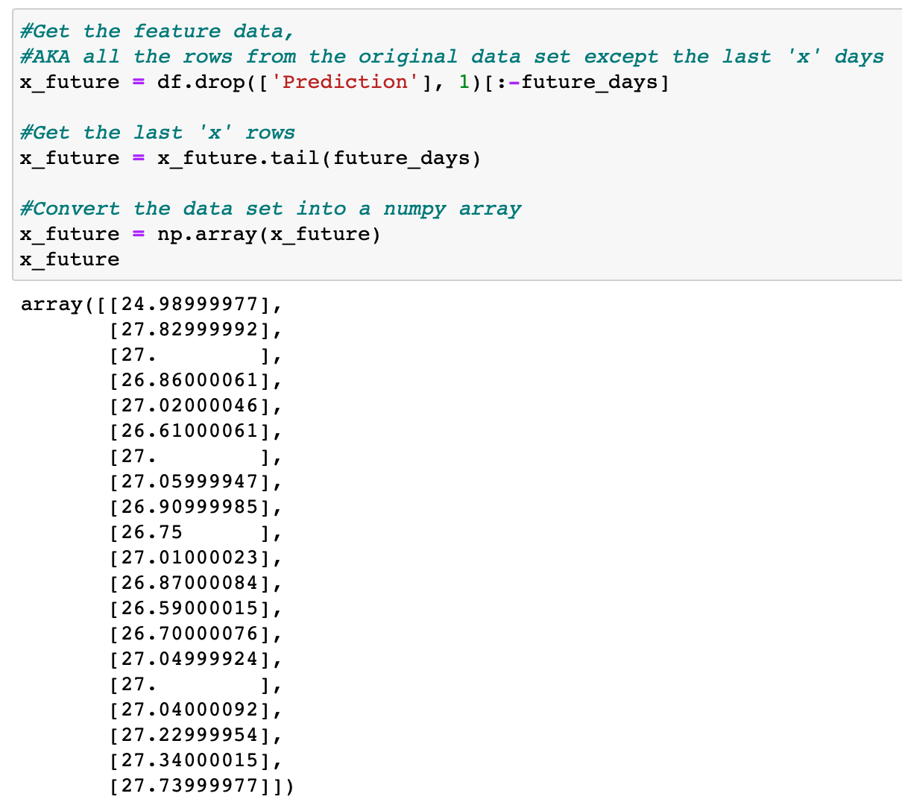
What Did I Do?
The original data (feature data) is gotten except or ‘x’ days
Converts the x_future data into a numpy array

Slide 12
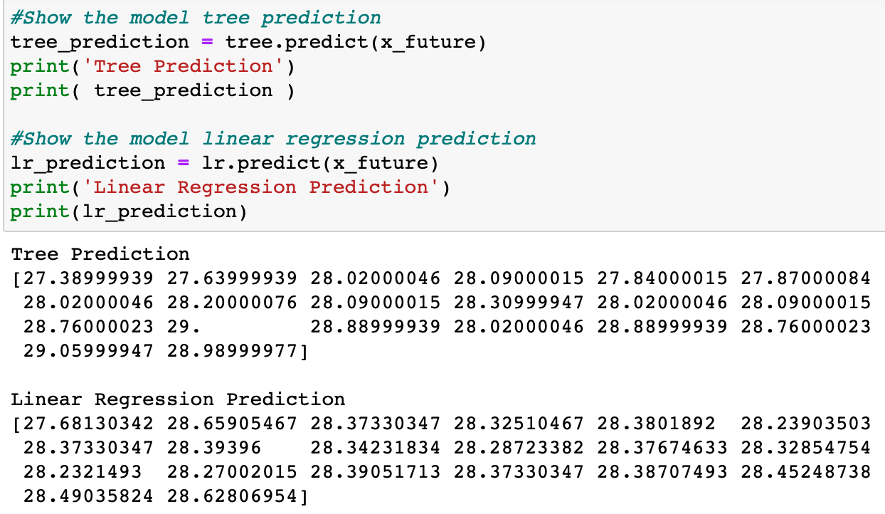
What Did I Do?

Slide 13
What Did I Do?

Slide 14
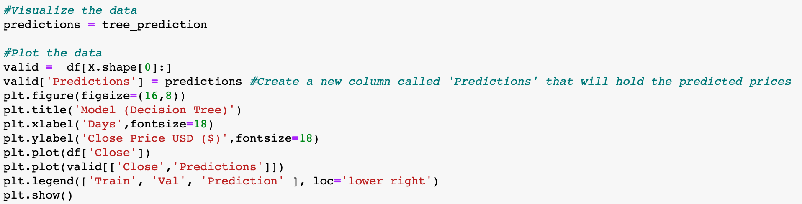
What Did I Do?
Code to visualize the Decision Tree model

Slide 15
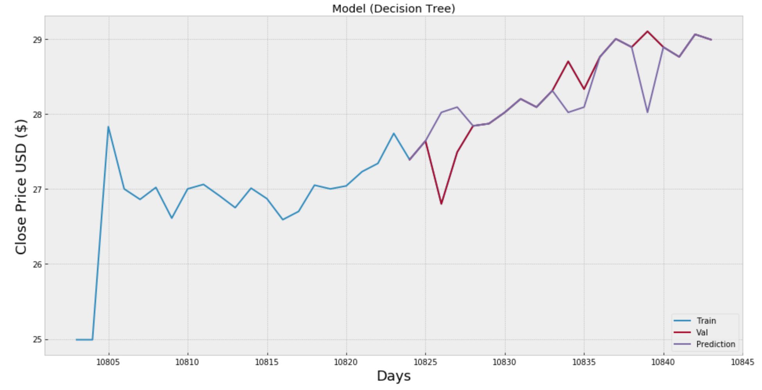
What Did I Do?
The Decision Tree Model

Slide 16
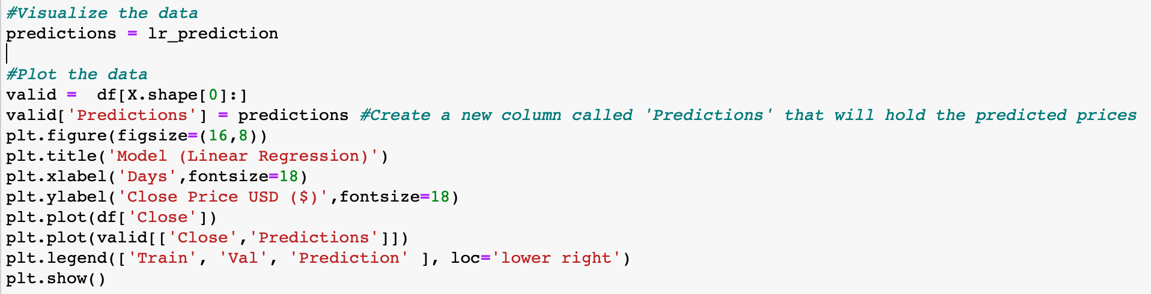
What Did I Do?
Code to visualize the Linear Regression model

Slide 17
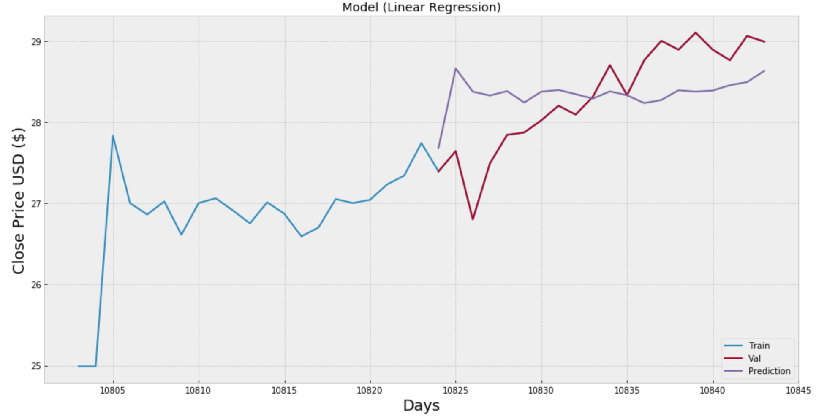
What Did I Do?
The Linear Regression Model

Slide 18
Why did I choose these methods?
Reasons the methods were chosen
The Decision Tree and Linear Regression seem to be common models to use when trying to predict stock market prices
Wanted to verify some of the various models to see if the information would appear closely
A lot of information on the Internet about how these models are used
Mainly used the Close Price to predict the information

Slide 19
Are the Experimental Methods Reliable?
As far as I know I properly evaluated the experiments with the stock datasets. I reviewed the AMZN and AACG stocks to verify if the information was being predicted in the same way. I also changed the time frames, and various other pieces of information to see how it changed the data. When I ran the code to review the Linear Regression and Decision Tree model graphs, there was a few different ways it calculated the predictions of the data.
When I computed the linear regression and decision tree model, there was not much preprocessing of the data that needed to be completed. I restricted the time frame that appeared in the dataset but other than that, the dataset was in good shape.

Slide 20
What Evaluation Did I Use?
Since stock prices and stock markets are volatile and there are many unknowns, it is hard to tell whether the models can be reliable or not
With the information that I reviewed for the Linear Regression and Decision Tree models, I would think they would be more reliable if stocks did not fluctuate as much
As with most things, experience and researching the various models and methods will help with making the models more accurate
The Decision Tree seemed to be the most accurate as it seemed to follow more of the fluctuations in predicting the future stock close price
I did use some statistical significance when I was evaluating the data by comparing the Open and Close prices, High and Low prices, and the Volume to see if I could see any patterns that appeared

Slide 21
Do My Conclusions Match My Results?
Overall, it is tough to try to predict future stock Close prices based on many unknowns that factor into the prices
I believe with more experience and research, machine learning can help with stock price forecasts
While it seems like machine learning has been used a lot with trying to predict stocks, people should consider other methods outside of machine learning
The other information may be able to show patterns in the data that may not appear in machine learning models and methods
When there is more historical data that is used, it seems to help predict the stock Close prices better
When there is not as much data that is used, there could be issues with the training of the datasets as it will not have a lot of the historical data
The forecasts will be skewed when there is stock volatility based on recent and past history and the time frame that is used
These models may be better used when the data is not as unpredictable
Overall, it is possible when more preprocessing tasks are completed, the models can be trained to create more of an accurate picture

